Slide 1
Data Mining

Slide 2
Group Members
Bcsf18m010-Muhammad Junaid
Bcsf18m032-Atif Javaid
Bcsf18m036-Muhammad Azam
Bcsf18m055-Muhammad Omer Sharif

Slide 3
What is Data Mining?
Data Mining is the technique to extract meaningful, hidden and unexpected information, trends and
patterns from huge amount of data which queries and reports can’t even handle effectively.

Slide 4
“The process of extracting valid, previously unknown, comprehensible, and actionable information from large databases and using it to make crucial business decisions is called Data Mining”

Slide 5
Why Data Mining is useful?
Simply storing information in a data warehouse does not provide the benefits that an organization is seeking. but with data mining we can extract patterns and trends by statistical analysis which can be very useful for an organization like predicting the future trends and checking which product caused surge in their income etc. Data mining can provide huge paybacks for companies who have made a significant investment in data warehousing.

Slide 6
Uses of Data Mining
Data mining is used in a wide range of companies some of them are following.
Retail/Marketing
Identifying buying patterns of customers
Finding associations among customer demographic characteristics
Predicting response to mailing campaigns
Market basket analysis

Slide 7
Uses of Data Mining (Cont.)
Banking
Detecting patterns of fraudulent credit card use
Identifying loyal customers
Predicting customers likely to change their credit card affiliation
Determining credit card spending by customer groups

Slide 8
Uses of DM (Cont.)
Insurance
Claims analysis
Predicting which customers will buy new policies
Medicine
Characterizing patient behavior to predict surgery visits
Identifying successful medical therapies for different illnesses

Slide 9
Data Mining Techniques
1

Slide 10
Data Mining Techniques include Four Major operations
Predictive Modeling
Database Segmentation
Link Analysis
Deviation Detection

Slide 11
Predictive Modeling

Slide 12
Predictive Modeling
Predictive modeling can be used to analyze an existing database to determine some essential characteristics (model) about the data set.
The model is developed using a supervised learning approach, which has two phases:
Testing
Training

Slide 13
Training
Training builds a model using a large sample of historical data called a training set.
Testing
Testing involves trying out the model on new, previously unseen data to determine its accuracy and physical performance characteristics.

Slide 14

Application of Predictive Modeling
Credit approval
Cross-selling
Direct marketing
There are two techniques associated with Predictive Data Modeling:
Classification
Value prediction

Slide 15
Classification
Classification is used to establish a specific predetermined class for each record in a database from a finite set of possible class values.

Slide 16
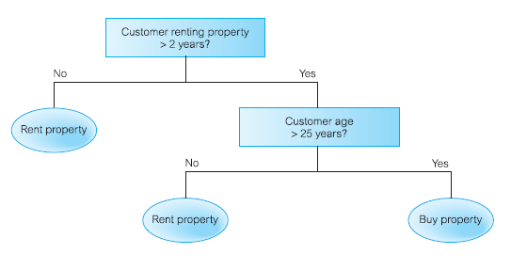
Specializations of Classification
There are two specialization of classification:
Tree induction
Neural induction
An example of classification using tree induction

Slide 17
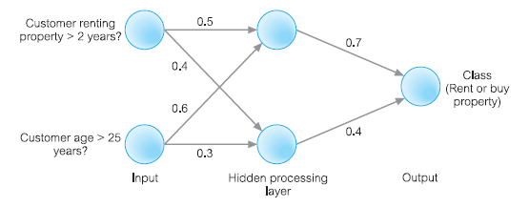
An example of classification using neural induction

Slide 18
Value Prediction
Value prediction is used to estimate a continuous numeric value that is associated with a database record.
This technique uses the traditional statistical techniques of linear regression and nonlinear regression.

Slide 19
Applications of Value Prediction
Credit card fraud detection
Target mailing list identification

Slide 20

Data Segmentation

Slide 21
Database Segmentation
Database segmentation is to partition a database into an unknown number of segments, or clusters, of similar records, that is, records that share a number of properties and so are considered to be homogeneous.
This approach uses unsupervised learning to discover homogeneous subpopulations in a database to improve the accuracy of the profiles.

Slide 22

Applications of Data Segmentation
Customer profiling
Direct marketing
Cross-selling
An example of database segmentation using a scatterplot shown in Figure:

Slide 23
Link Analysis

Slide 24
Link Analysis
Specialization of Link Analysis
There are three specialization of link analysis:
Association discovery
Sequential pattern discovery
Similar time sequence discovery
Link analysis aims to establish links, called associations, between the individual records, or sets of records, in a database.

Slide 25
Specialization of Link Analysis
Association Discovery
It finds items that imply the presence of other items in the same event.
For example
When a customer rents property for more than two years and is more than 25 years old, in 40% of cases, the customer will buy a property.
Sequential Pattern Discovery
It finds patterns between events such that the presence of one set of items is followed by another set of items in a database of events over a period of time.
For example
This approach can be used to understand long-term customer buying behavior.
Similar Time Sequence Discovery
It is used in the discovery of links between two sets of data that are time-dependent, and is based on the degree of similarity between the patterns that both time series demonstrate.
For Example
Within three months of buying property, new home owners will purchase goods such as stoves, refrigerators, and washing machines.

Slide 26
Applications of Link Analysis
Product affinity analysis
Direct marketing
Stock price movement

Slide 27
Deviation Detection

Slide 28
Deviation Detection
Deviation detection is often a source of true discovery, because it identifies outliers, which express deviation from some previously known expectation and norm.
This operation can be performed using statistics and visualization techniques or as a by-product of data mining.

Slide 29
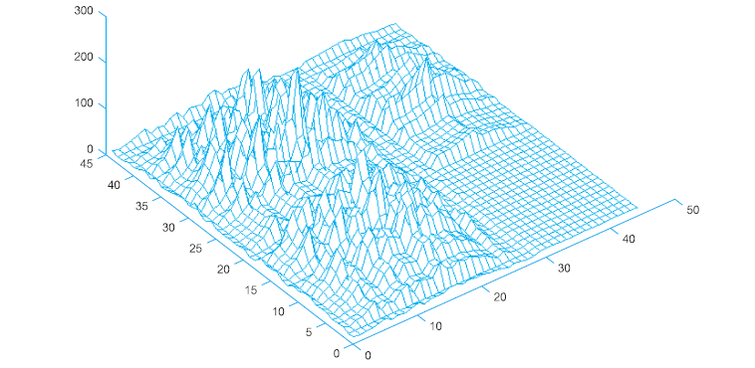
An example of visualization of the data shown in Figure:

Slide 30
Applications of Deviation Detection
Fraud detection in the use of credit card
Insurance claims
Quality control
Defects tracking

Slide 31
The CRISP-DM Model
2

Slide 32
The CRISP-DM Model
The CRISP-DM methodology is a hierarchical process model. Process is divided into six phases.
Business Understanding
Data Understanding
Data preparation
Modeling
Evaluation
Deployment

Slide 33
Phases of CDM Model (Cont.)
Business Understanding
This focuses on objectives and requirements of project. This converts business problem to data mining problem. Determine business objectives, assess situation, determine data mining goal and produce project plan are the tasks involved in it.
Data Understanding
Data collection is included in this phase which establishes main characteristics of data in which data structure and quality, identifying subset of data are included. Collecting initial data describing the data, and verifying data quality are included in this phase.
Data Preparation
This includes all the activities for constructing final data set for applying modeling tool directly. Selecting data, cleaning data, constructing data, integrating data and formatting the data are included in this phase.

Slide 34
Phases of CDM Model (Cont.)
Modeling
In this phase involves selecting modeling techniques and modeling parameters and assessing created model. Select modeling technique, generate test design, build model, and assess model are the tasks in this phase.
Evaluation
This validates model in view of data analysis. Evaluate results, review process, and determine next steps are the tasks in this phase.
Deployment
This phase can be simple as generating a report. The business user normally executes the deployment phase. Plan deployment, plan monitoring and maintenance, produce final report, and review report are the steps involved in this phase.

Slide 35
Data Mining Tools
2

Slide 36
Data Mining Tools
There are a growing number of commercial data mining tools on the marketplace. The important features of data mining tools include:
Data Preparation
Selection of Mining operations
Product scalability & Performance
Facilities for understanding results

Slide 37
Data Preparation
Data preparation is the most time-consuming aspect of data mining. Some of the functions that a tool may provide to support data preparation include:
Data cleansing: such as handling missing data.
Data describing: such as the distribution of values.
Data transforming: such as performing calculations on existing columns.
Data sampling: for creation of training and validation data sets.

Slide 38
Selection of Mining Operations
It is important to understand the characteristics of the operations used by a data mining tool to ensure that they meet the user’s requirements. An important feature of an algorithm is its sensitivity to noise. In particular, it is important to establish that:
How the algorithms treat the data types of the response and predictor variables?
How fast they train?
How fast they work on new data?
How sensitive a given algorithm is to missing data?
How robust are the patterns it discovers in the face of extraneous and incorrect data?

Slide 39
Selection of Mining Operations
~ Noise : Noise is the difference between a model and its predictions. Sometimes data is referred to as being noisy when it contains errors such as many missing or incorrect values or when there are extraneous columns.
~ Predictor Variables : A predictor variable is the column in a database that can be used to build a predictor model, to predict values in another column.

Slide 40
Product Scalability & Performance
Scalability and performance are important considerations when seeking a tool that is capable of dealing with increasing amounts of data in terms of numbers of rows and columns possibly with sophisticated validation controls. The need to provide scalability while maintaining satisfactory performance may require investigations into whether a tool is capable of supporting parallel processing using technologies such as Symmetric Multi-Processing (SMP) or Massively Parallel Processing (MPP) or not?

Slide 41
Facilities for Understanding Results
A good data mining tool should help the user understand the results by providing measures such as those describing accuracy and significance in useful formats (e.g. confusion matrix). By allowing the user to perform sensitivity analysis on the result, and by presenting the result in alternative ways (using, for example, visualization techniques)

Slide 42
Facilities for Understanding Results
Sensitivity analysis determines the sensitivity of a predictive model to small fluctuations in predictor value. Through this technique end-users can gauge the effects of noise and environmental change on the accuracy of the model.
Confusion matrix : A Confusion matrix shows the counts of the actual versus predicted class values. It shows not only how well the model predicts, but also presents the details needed to see exactly where things may have gone wrong

Slide 43
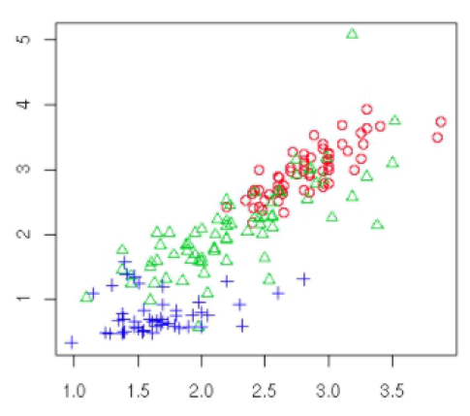
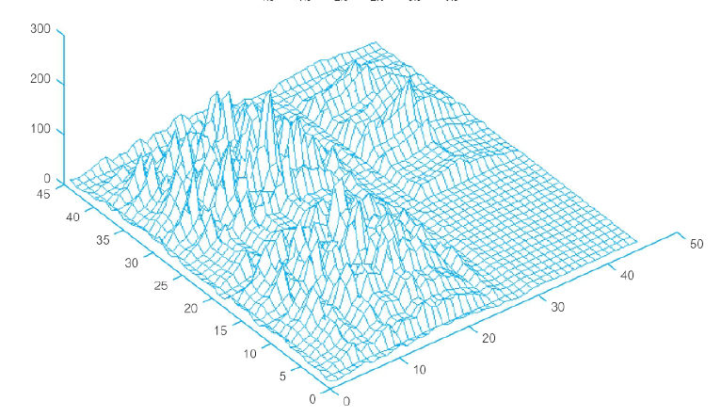
Facilities for Understanding Results
Visualization graphically displays data to facilitate better understanding of its meaning. Graphical capabilities range from simple scatter plots to complex multidimensional representations.

Slide 44
Data Mining & Data Warehouse
2

Slide 45
Data Mining & Data Warehouse
Data mining requires a single, separate, clean, integrated, and self-consistent source of data. Following are the reasons of data warehouse for providing data mining:
Quality and flexibility of data are the requirement of mining for ensuring accuracy of model.
Mining data from multiple sources is beneficial. Data warehouse contain data from many sources.
Selecting appropriate subsets of fields and records for mining need query capabilities.
Data mining is useful and data warehouse give us facility for back to data source.

Slide 46
Oracle Data Mining
2

Slide 47
Oracle Data Mining
Two major types of analysis are:
OLAP and
Data mining.
Oracle has integrated OLAP and data mining capabilities directly into the database server.

Slide 48
Data Mining Capabilities
An API that provides programmatic control and application integration;
analytical capabilities with OLAP and statistical functions in the database.
multiple algorithms: Naïve Bayes, Decision Trees, Clustering, and
Association Rules.
real-time and batch scoring modes.
multiple prediction types.
association insights.

Slide 49
Prediction & Insights
ODM uses data mining algorithms to sift through the large volumes of data generated by e-businesses to produce, evaluate, and deploy predictive models.
ODM delivers real-time answers to questions such as:
Which N items is person A most likely to buy or like?
What is the likelihood that this product will be returned for repair?

Slide 50
Oracle Data Mining Environment
The Oracle Data Mining environment supports all the phases of data mining within the database. For each phase the ODM environment results in significant improvements in such areas as performance, automation, and integration.
The important features of ODM tools include:
Data Preparation.
Model Building.
Model Evaluation.
Scoring.

Slide 51
Oracle Data Mining Environment
Data preparation
Data preparation can create new tables or views of existing data. ODM provides utilities for complex, data mining-specific tasks. Binning improves model build time and model performance, so ODM provides a utility for user-defined binning.
Associated analysis for preparatory data exploration and model evaluation is extended by Oracle’s statistical functions and OLAP capabilities. They can all be incorporated into a seamless application, which allows for more functional and faster applications.

Slide 52
Oracle Data Mining Environment
Model building
Oracle Data Mining provides four algorithms:
Naïve Bayes.
Decision Tree
Clustering
Association Rules
These algorithms address a broad spectrum of business problems, ranging from:
predicting the future likelihood of a customer purchasing a given product.
To understanding which products are likely to be purchased together in a single trip to the grocery store

Slide 53
Oracle Data Mining Environment
Model evaluation
ODM provides APIs for calculating traditional confusion matrices and lift charts. It stores;
The models.
The underlying data.
To allow further analysis, reporting, and application-specific model management.

Slide 54
Oracle Data Mining Environment
Scoring
Oracle Data Mining provides both batch and real-time scoring. In both modes, ODM can deliver a variety of scores. It can return a rating or probability of a specific outcome. Alternatively, it can return a predicted outcome and the probability of that outcome occurring.
Examples:
• How likely is this event to end in outcome A?
• Which outcome is most likely to result from this event?
• What is the probability of each possible outcome for this event?

Slide 55
Data Mining Features
Enables you to easily build and deploy next-generation applications that deliver predictive analytics and new insights.
Application developers can rapidly build next-generation applications using ODM’ and deploy results in real-time throughout the enterprise.
Because the data, models, and results remain in the Oracle Database, So
Data movement is eliminated.
Security is maximized
Information latency is minimized.

Slide 56
THANKS!
Any questions?

